Slide 2
Unit
1
HOBBIES
LESSON 6: SKILLS 2

Slide 3
OBJECTIVES
By the end of the lesson, students will be able to:
listen for specific information about Trang’s hobby
write a passage about her hobbies

Slide 4
LESSON 6: SKILLS 2
WARM-UP
Chatting
Task 1: Look at the picture. What hobby is it? Do you think it is a good hobby? Why or why not?
Task 2: Listen and complete the mind map.
LISTENING
Task 3: What is your hobby? Fill in the blank below.
Task 4: Write a paragraph about your hobby.
WRITING
POST-LISTENING
& WRITING
Class gallery
CONSOLIDATION
Wrap-up
Homework

Slide 5
LESSON 6: SKILLS 2
WARM-UP
Chatting
Aims of the stage:
to prepare students for the listening text

Slide 6
WARM-UP
What will you mention when you talk about someone’s hobby?
The time he / she started the hobby
His / Her feelings about the hobby
His / Her future plan about the hobby

Slide 7
LESSON 6: SKILLS 2
WARM-UP
Chatting
Task 1: Look at the picture. What hobby is it? Do you think it is a good hobby? Why or why not?
Task 2: Listen and complete the mind map.
LISTENING
Aims of the stage:
to help students develop listening skills for specific information

Slide 8
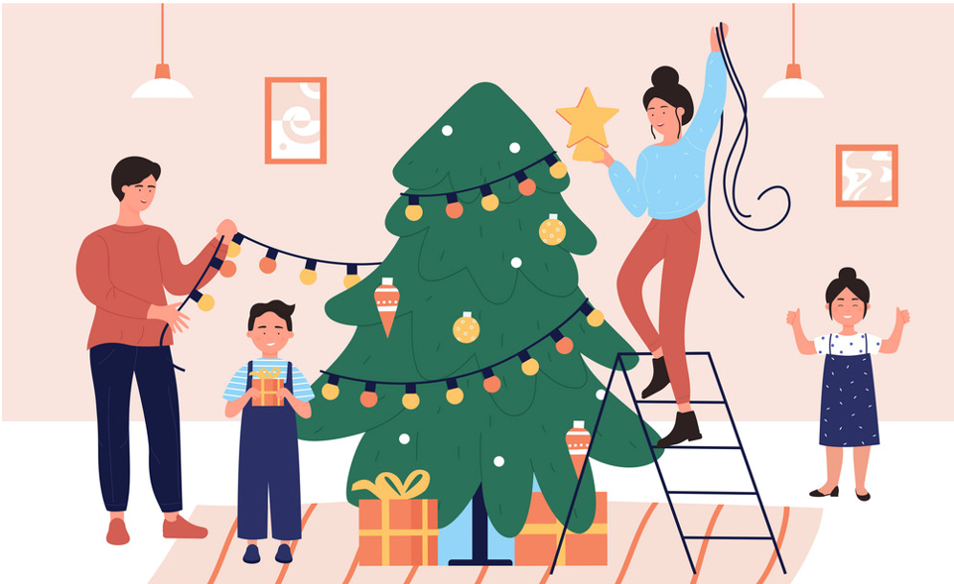
Vocabulary
decorate (v)
/ˈdekəreɪt/
trang trí

Slide 9
Vocabulary
benefit (n)
/ˈbenɪfɪt/
lợi ích

Slide 10
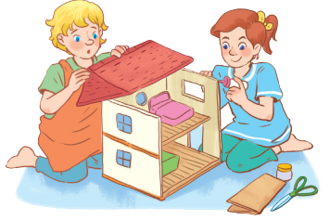
PRE-LISTENING
1
Look at the picture.
What hobby is it?
Do you think it is a good hobby? Why or why not?

Slide 11
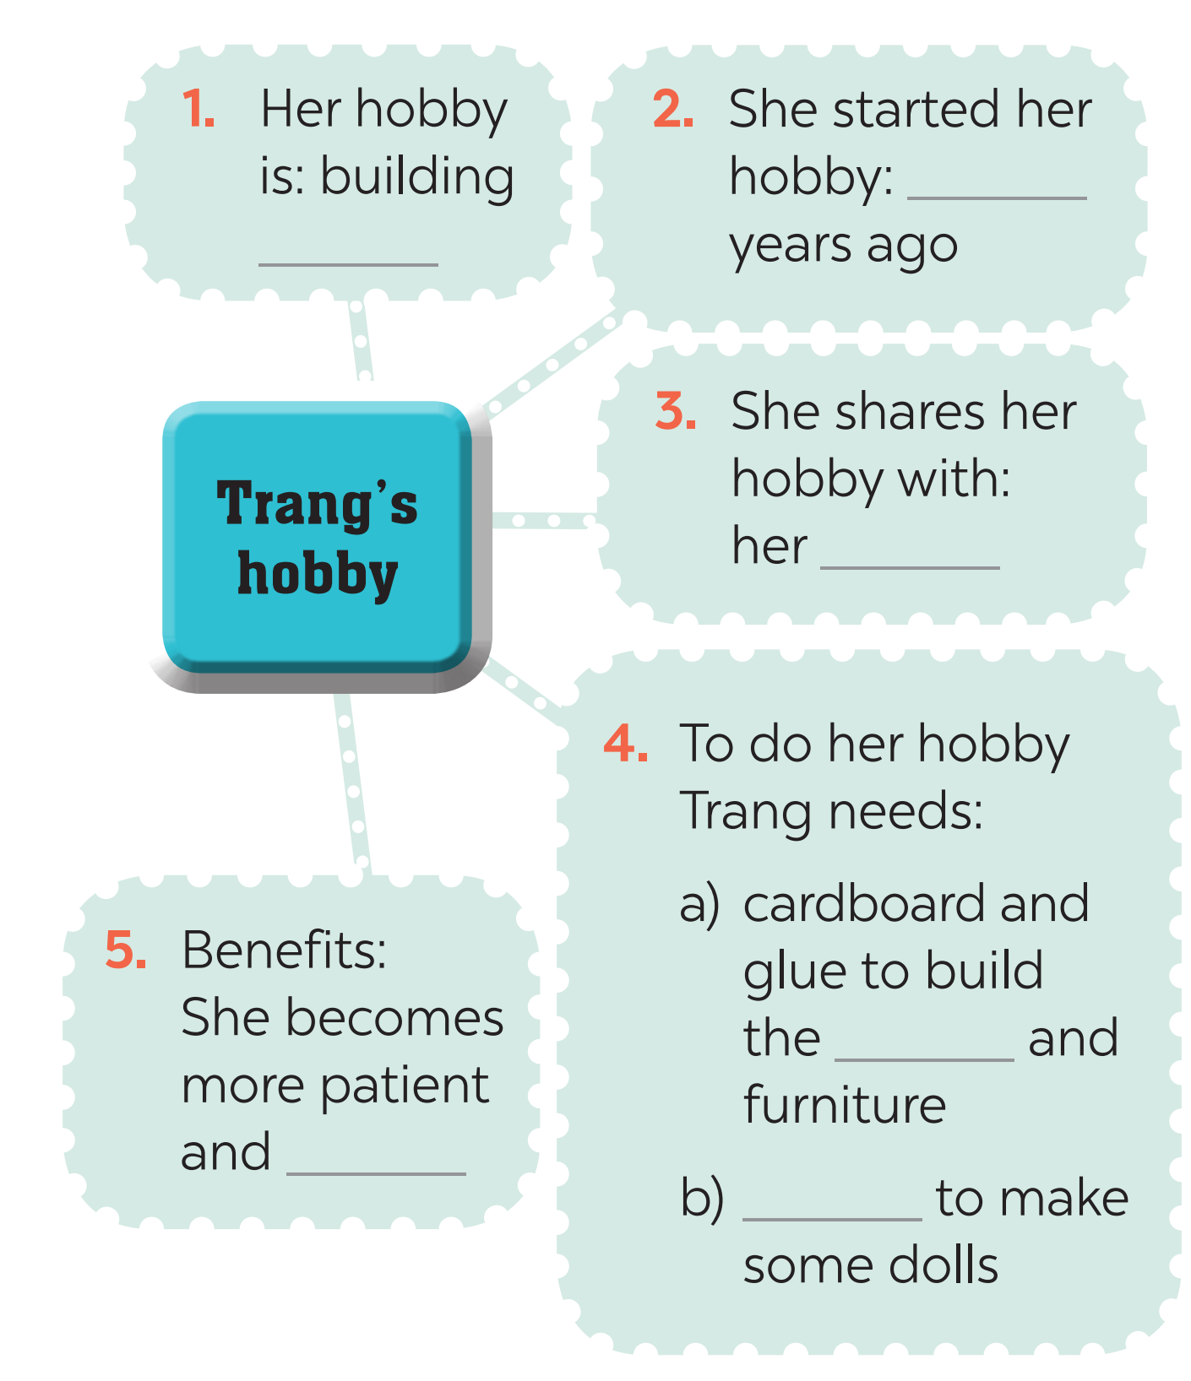
WHILE-LISTENING
2
Listen to an interview about Trang’s hobby. Fill in each blank in the mind map with one word or number.
three
dollhouses
cousin
house
creative
cloth

Slide 12
LESSON 6: SKILLS 2
WARM-UP
Chatting
Task 1: Look at the picture. What hobby is it? do you think it is a good hobby? Why or why not?
Task 2: Listen and complete the mind map.
LISTENING
Task 3: What is your hobby? Fill in the blank below.
Task 4: Write a paragraph about your hobby.
WRITING

Slide 13
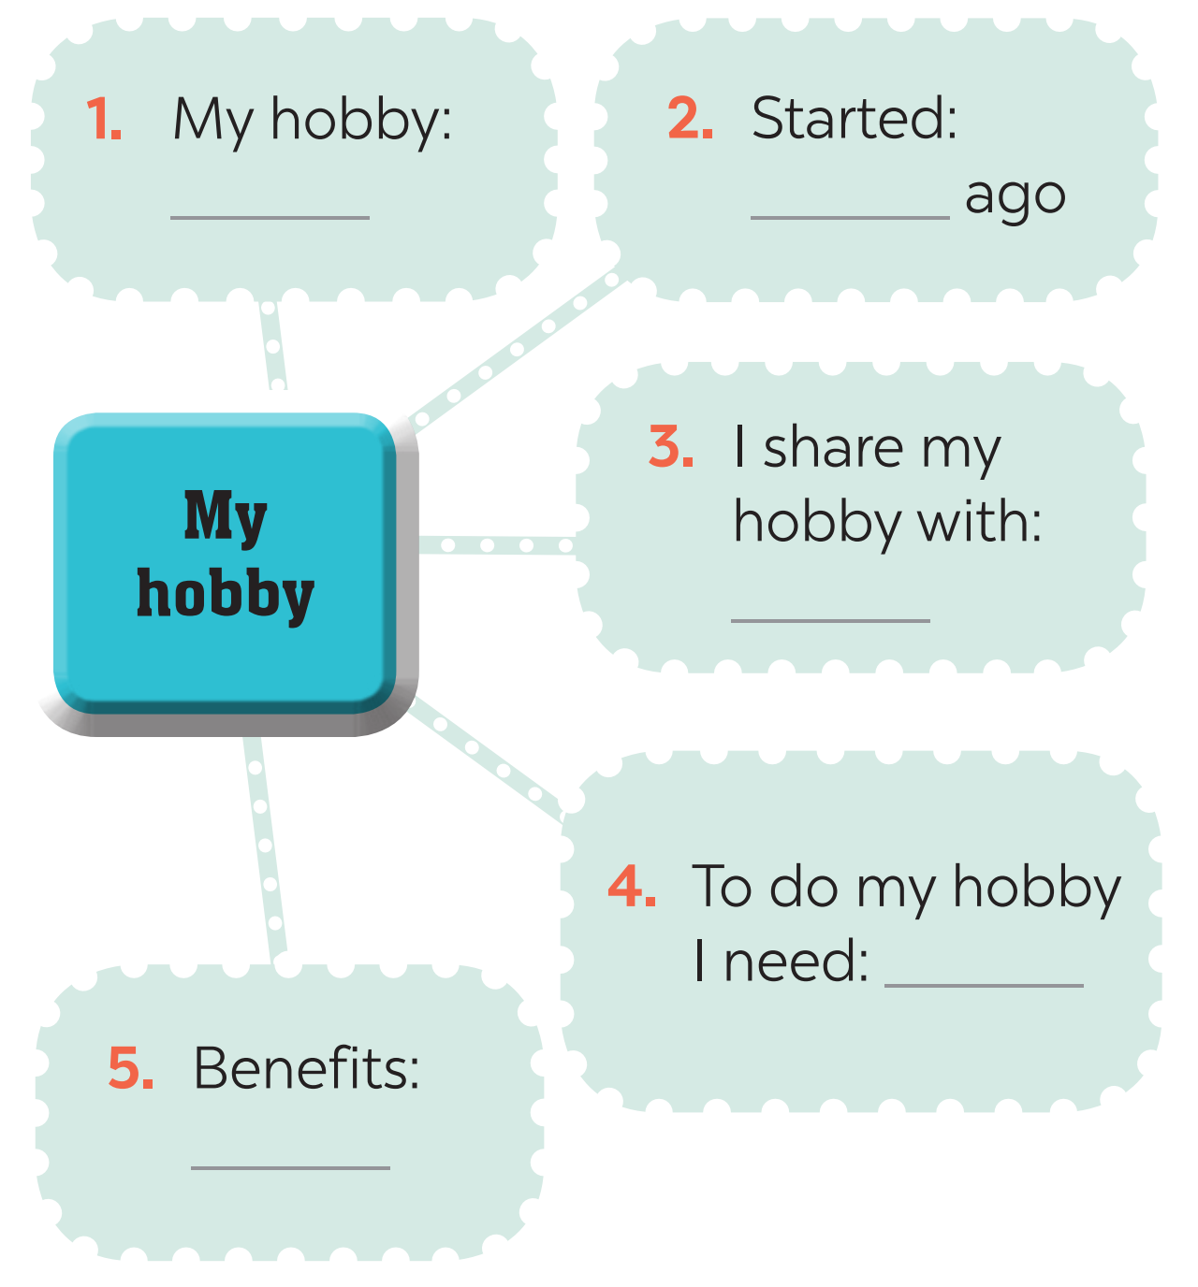
PRE-WRITING
3
What is your hobby? Fill in the blanks below.

Slide 14
WHILE-WRITING
4
Now write a paragraph of about 70 words about your hobby. Use the notes in Task 3. Start your paragraph as shown below.
My hobby is ___________________________________ ___________________________________________________ ___________________________________________________ ___________________________________________________ ___________________________________________________ ___________________________________________________ ___________________________________________________

Slide 15
WHILE-WRITING
4
Now write a paragraph of about 70 words about your hobby. Use the notes in Task 3. Start your paragraph as shown below.
Example: My hobby is gardening. I started my hobby 3 years ago. I really like it because I can do it with my family. My family can join in and do something together. We usually spend 1 hour on Sunday morning in our garden. I need some plants, gloves, pots and soil to do my hobby. Gardening has many benefits. It helps me become more patient and responsible. I also learn about insects and bugs. Gardening can help us to protect our environment.

Slide 16
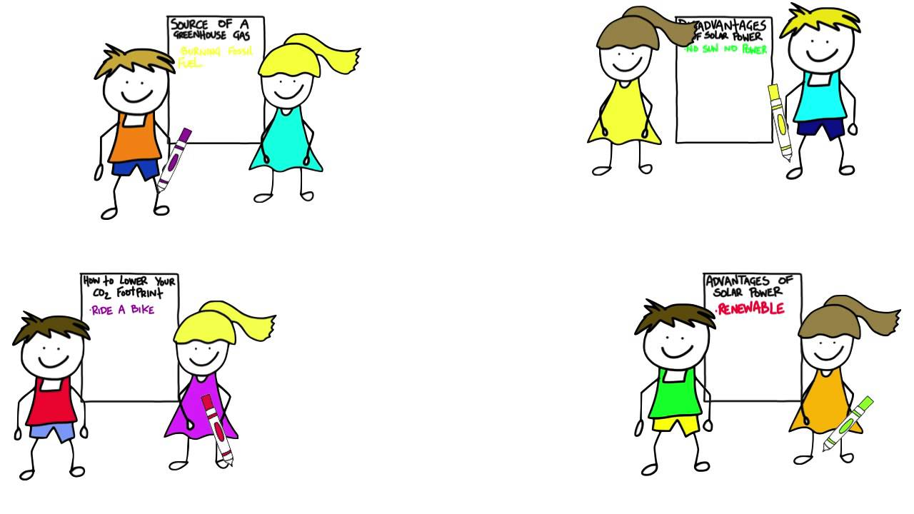
PRODUCTION
CLASS GALLERY
Students can:
go and see others’ work
give comments to one another

Slide 17
CONSOLIDATION
1
WRAP-UP
In this lesson, we have learnt to:
listen for specific information about Trang’s hobby
write a passage about her hobbies

Slide 18
CONSOLIDATION
2
HOMEWORK
Prepare for the next lesson: Looking back & Project

Slide 19
Website: hoclieu.vn
Fanpage: facebook.com/www.tienganhglobalsuccess.vn/

